Slide 1
The role of partisanship in the battle with COVID-19
Talk Data to Me

Slide 2
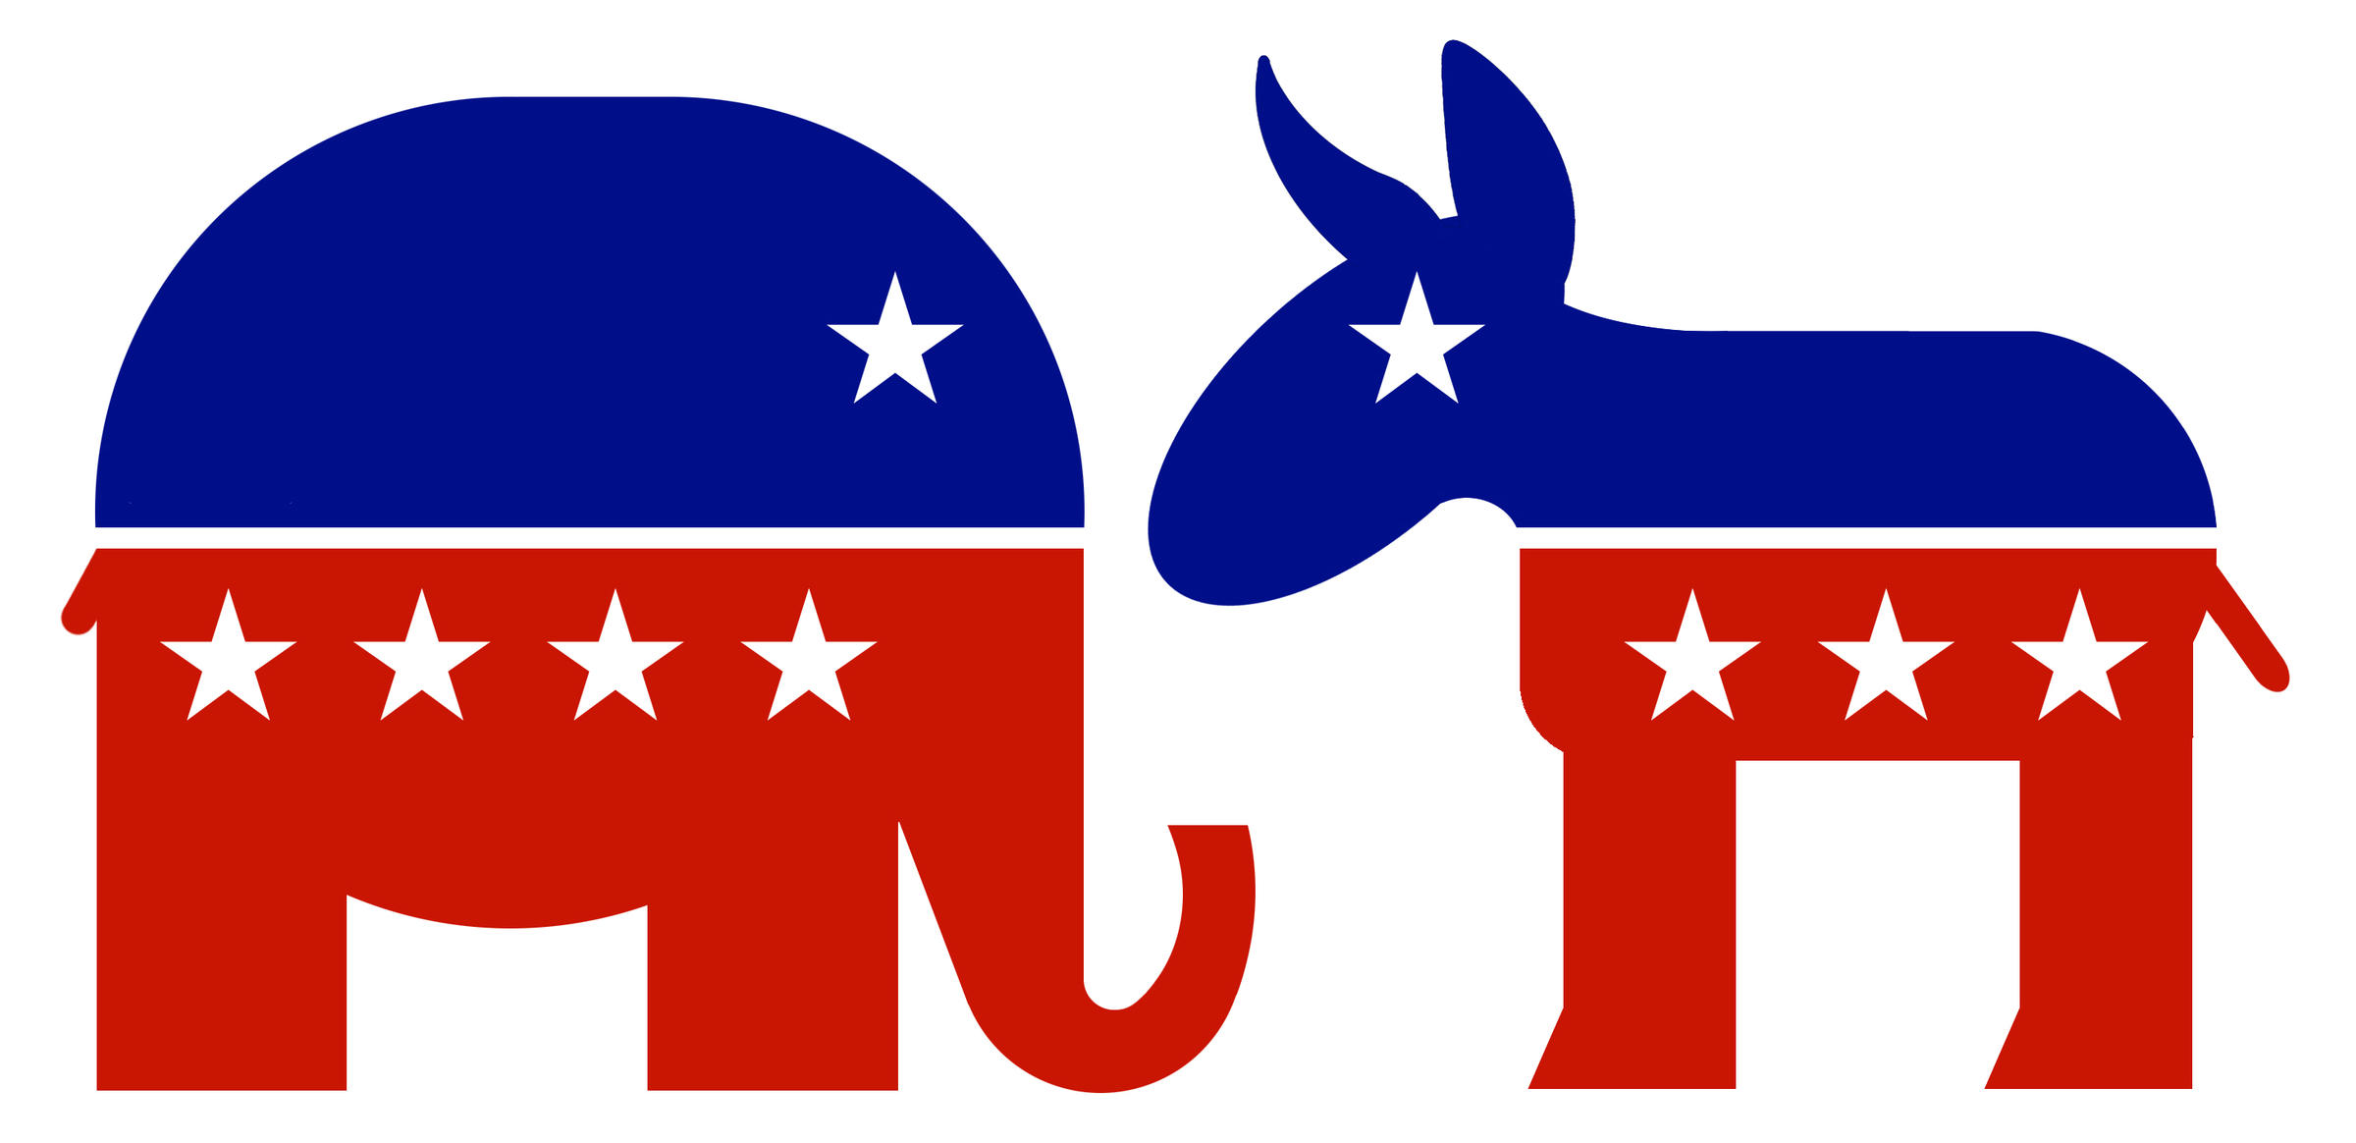
Is the split over COVID-19 really about politics?
+1.95 cases/1 million people/day
When comparing the Republican states to the Democratic states

Slide 3
Why do democratic states outperform republican states?
Government Interventions
Public Awareness
Community Mobility

Slide 4
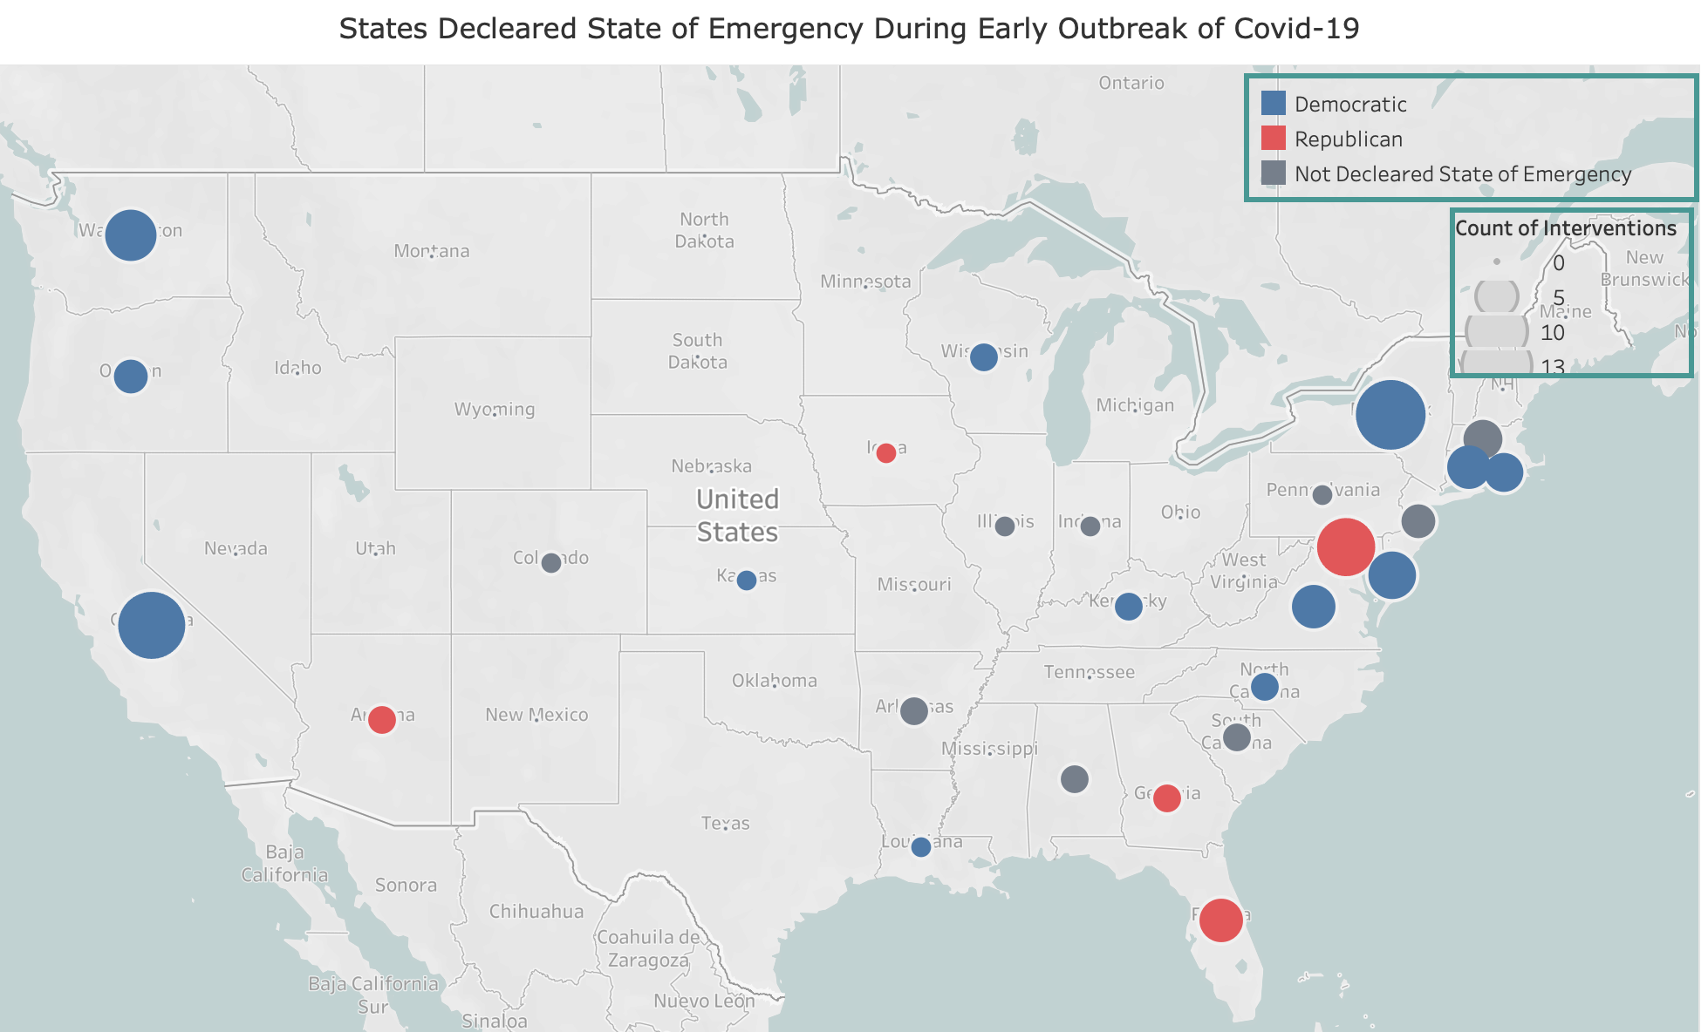
Government Intervention

Slide 5
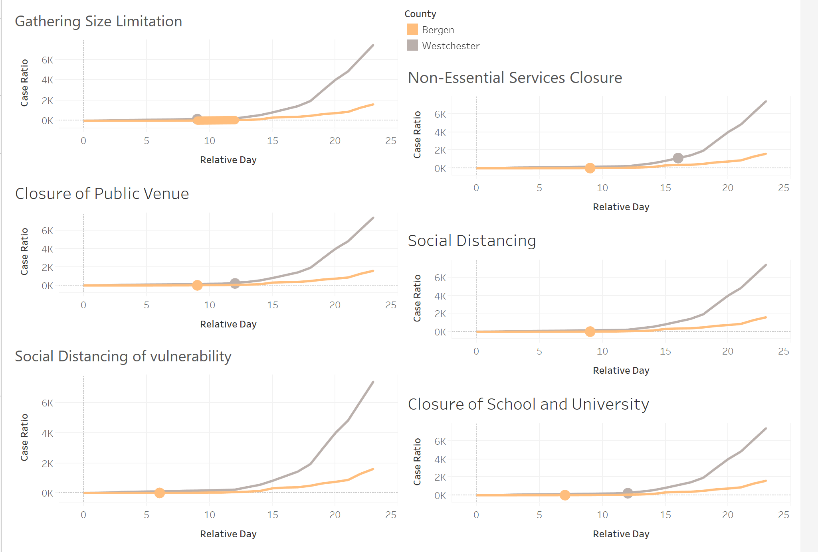


Does the intervention really matter?
Bergen
Westchester
Similar demographic attributes
Parallel trend before the intervention
Similar COVID-19 outbreak date
Time lag for all interventions

Slide 6
The Public Awareness
Tweets screenshots

Slide 7


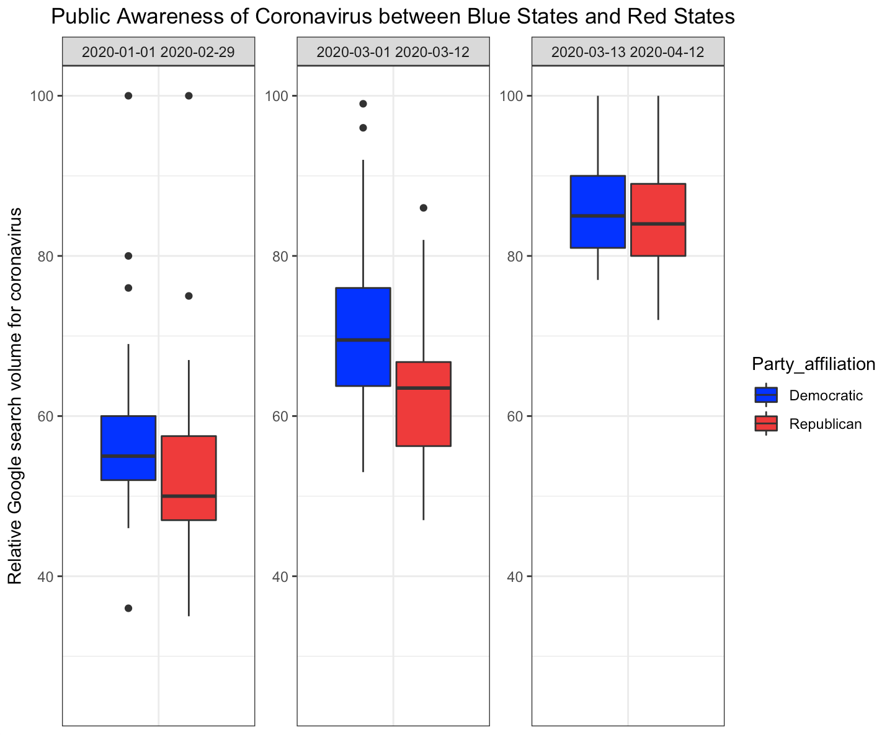
The Public Awareness
Finding:

Slide 8
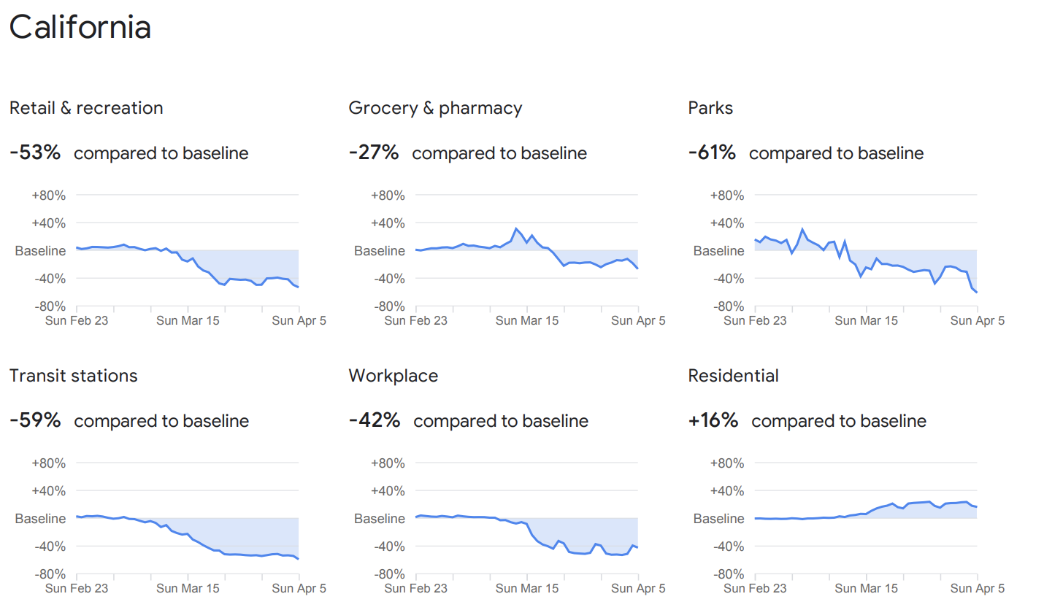
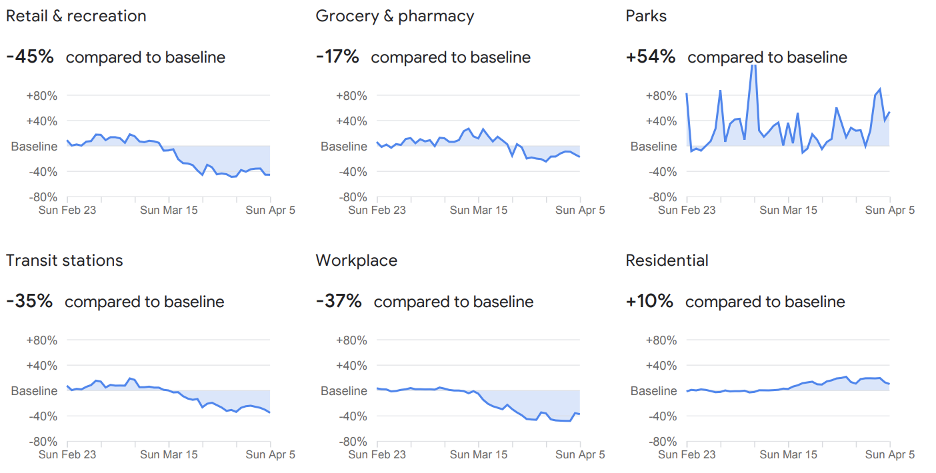
How does it all come to play?
California
130 cases / 1M
VS.
Indiana
250 cases / 1M

Slide 9
Could it be a fluke?
-0.9 decrease in new cases/1 million people can be achieved as a result of 1 unit decrease in mobility compared to the baseline
(Average new cases/million people is 3.67)

Slide 10
In summary, how does bipartisan affect the spread of COVID-19?
Partisanship
Intervention
COVID-19 Severity
Mobility
Public Awareness

Slide 11
What does the story tell us?
A state’s public awareness and government intervention is dependent on its political leaning.
Government intervention plays an important role in containing the spread.
Reduced mobility is effectively reducing severity.

Slide 12
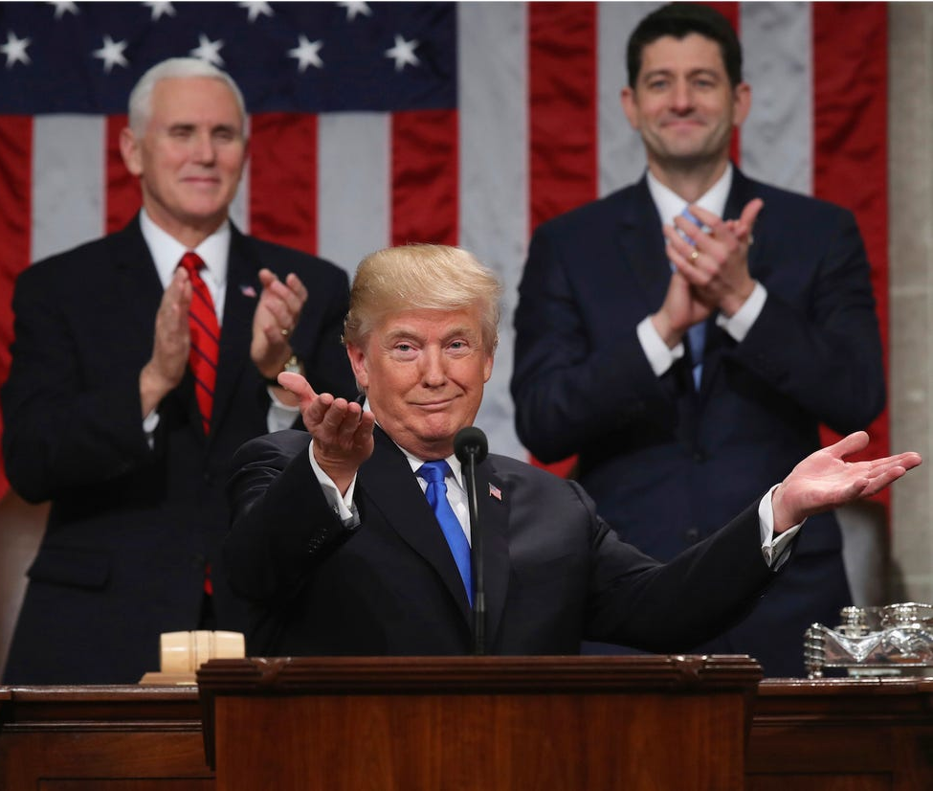
It is not about Democratic or republican
It is about making containing the COVID-19 align with the government political interest

Slide 13

The crisis calls for a collective response from both the Democratic and Republican Party

Slide 14
Data Sources
Party Affiliation | 2018 Midterm Election Result
Government Measures | Keystone Strategy
Social Awareness | Google Search Trends
Mobility | Google Community Mobility Report
Population | World Population Review
Time-Series Cases | John Hopkins CSSEGISandData

Slide 15
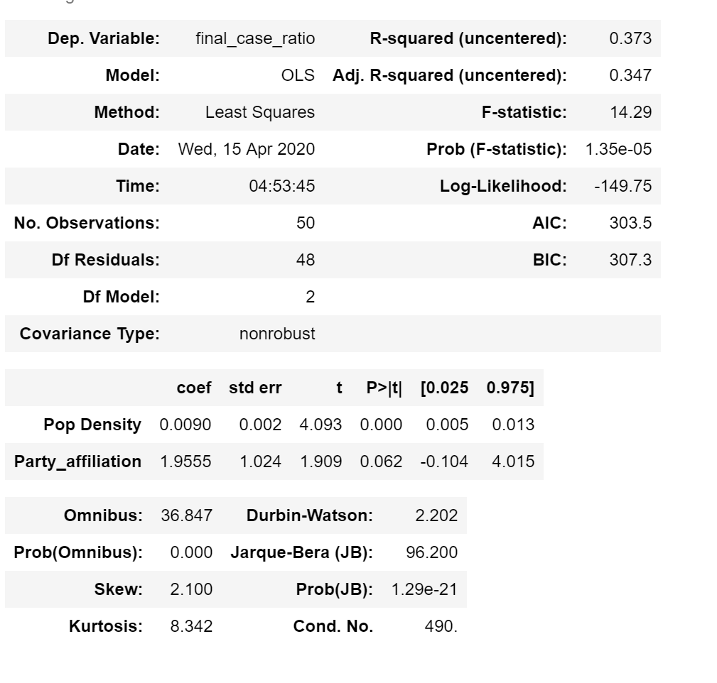
Appendix 1
Severity of the Covid-19 breakout between Blue States and Red States

Slide 16
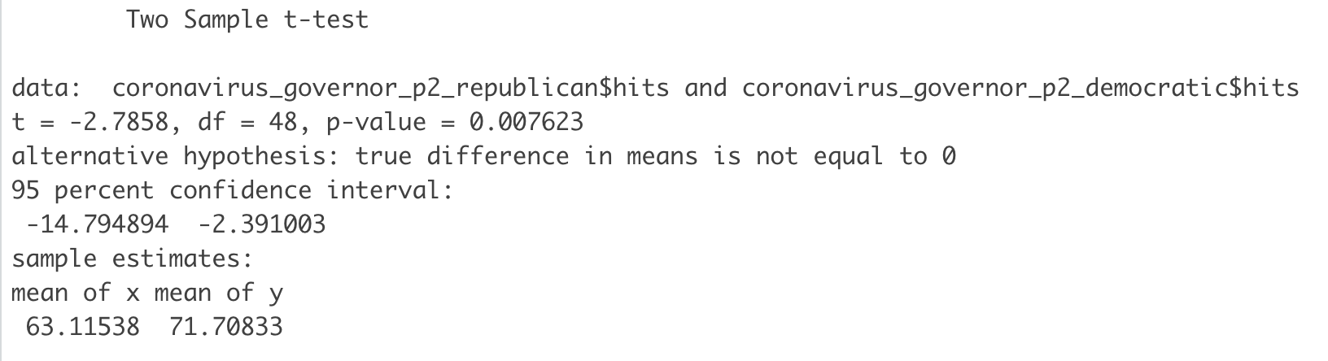
Appendix 2
Significant difference exists between Blue States and Red States during early outbreak of Covid-19

Slide 17
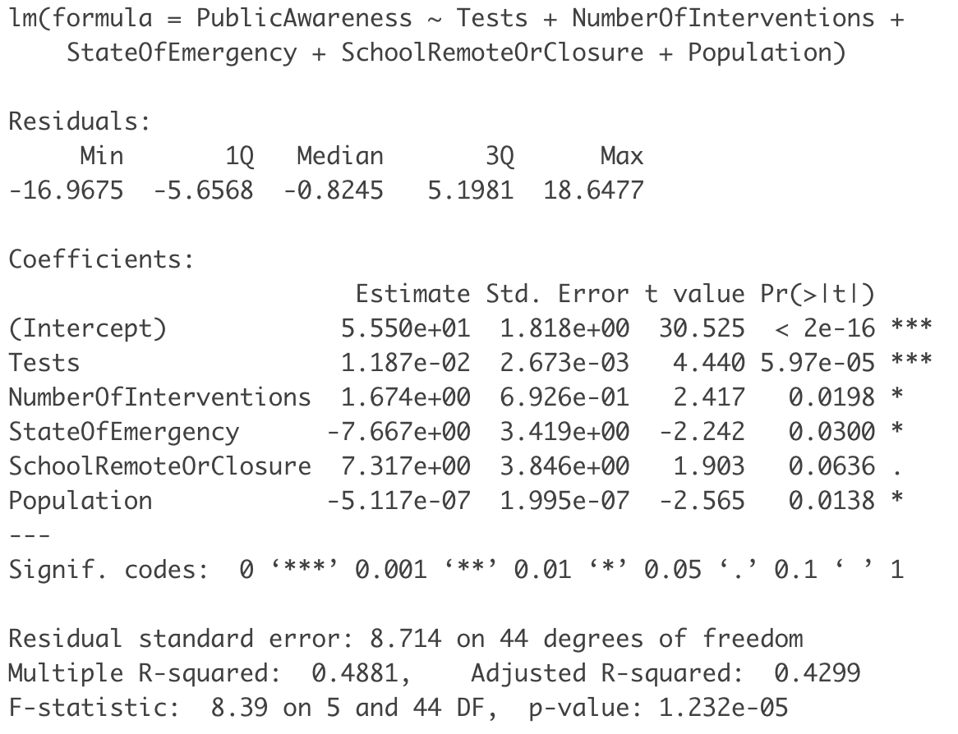
Appendix 3
Regress public awareness on interventions while control for number of tests and population by state

Slide 18
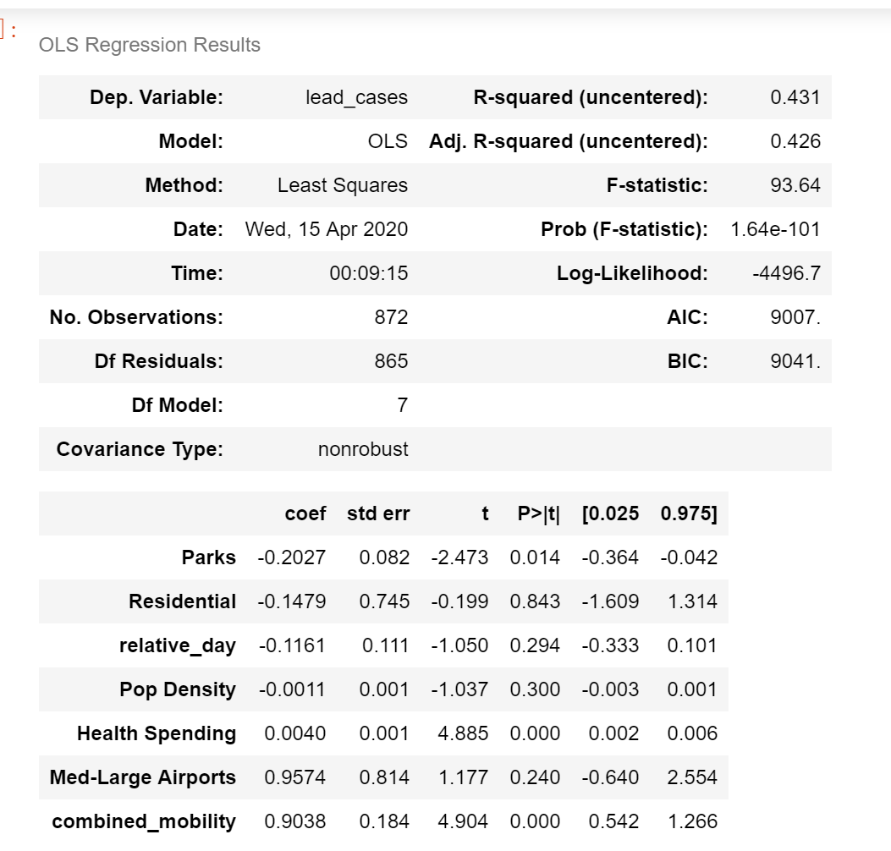
Appendix 4
Regress social mobility on lead cases while control for number state demographics

